Slide 1
Wando Beta Club 2018-2019!
Welcome

Slide 2
Join our Remind101!!
Text @wandobe to 81010

Slide 3
Website
www.wandobetaclub.weebly.com
Instead of a Facebook page, this year we have a website! Visit this site to find all of the dues forms and service hours forms and to access the powerpoint with service opportunities from every meeting. You can also find contact info, news, and updates on the site!

Slide 4
Service Hours
2nd semester service hours are due by May 17th. 18 service hours must be completed, and you can start turning them in May 1!

Slide 5
Service Opportunities
Charleston Outdoor Festival
April 13-14th
Different volunteer shifts needed including volunteering at the archery zone, climbing wall, bike obstacle course, cardboard canoe race, and mountain bike short track race (no experience required)
Contact tujcich@ccprc.com to help!

Slide 6
Service Opportunities
Mullet Haul Trail 5k/10k
April 27th through Charleston County Parks
Sign up to volunteer for the run by contacting tujcich@ccprc.com

Slide 7
Service Opportunities
Walk MS: Charleston
May 4th at James Island County Park
Volunteers needed for set-up, clean-up, rest stops, finish line cheering, and more
Visit the Walk MS: Charleston Sign Up Genius link to sign up for as many or as little positions as you want
https://www.signupgenius.com/go/20f0944acab22abfd0-2019245

Slide 8
Service Opportunities
School Supplies Drive with Student Council
Wando Stuco is running a school supplies drive to collect various items for low-income schools within our district
You can receive 1 service hour for 2 items

Slide 9
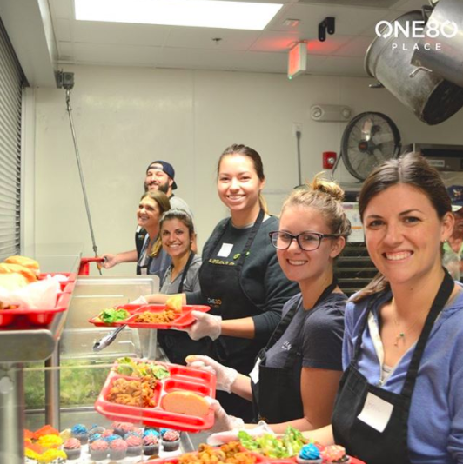
Service Opportunities
One80 Place Soup Kitchen Volunteering
Volunteers are always needed to serve lunch at One80 Place, a homeless shelter in downtown Charleston
To volunteer, sign up for a day and time slot through the link below!
https://one80place.volunteerhub.com/?format=Calendar&filter=34867

Slide 10
Habitat for Humanity ReStore
To volunteer, go to the ReStore and sign up
Once enrolled, you can volunteer whenever you want for however long you want!
469 Long Point Rd.

Slide 11
Service Opportunities
Tissue Supply Drive
Turn in three boxes for one hour. Available for up to three hours
Turn in to room E208 by 4/15

Slide 12
Future Meeting Dates
2nd Tuesday of every month!
7:45 am or 3:50 pm in the PAC!
May 14th

Slide 13
Wando Beta Club 2018-2019!
Our next meeting is…
May 14th!
In the PAC at 7:45am
and 3:50pm

